Slide 1
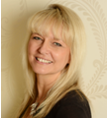
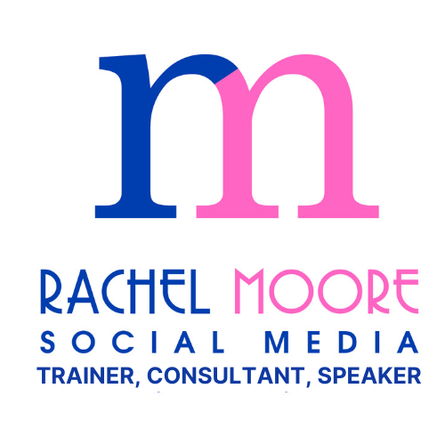
Testimonials
For
Rachel Moore Social Media

Slide 2
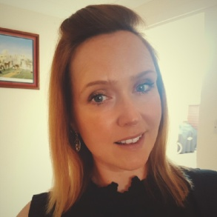
Rachel did a great training session with us here at Aardvark Swift. We needed some help on LI profile optimisation and ensuring we were posting content that allowed us to engage with our target market.
Rachel demonstrated how we needed to position ourselves as a thought leader and how to build meaningful connections and develop relationships.
We'd highly recommend Rachel for SM support and training!
Kelly Blank | Aardwark Swift Gaming Recruiter

Slide 3
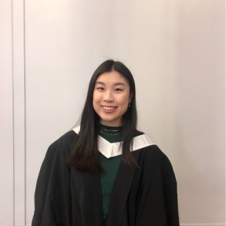
As a marketing professional, I can't emphasis enough how important social media is, Rachel's sessions are not only informative, it is FUN, and I've learned so much from her.
She tailored her sessions according to our social media needs and understanding, her suggestions are very helpful.
Rachel is an outstanding social media trainer and I highly recommend her training session whether you are new to social media or a frequent user.
Cynthia Wong | Marketing Assistant VIDA Healthcare

Slide 4
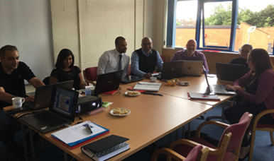
Rachel delivered a workshop to myself and 8 other franchisees, all with different levels of experience and knowledge of using Facebook for business.
Rachel was able to manage the learning curve for all of us and delivered an interesting and informative and interactive workshop from which everyone of us benefited.
Excellent value for money, an enjoyable learning experience – highly recommended!!
Phil Mason | Regional Manager & Caremark Mansfield Franchisee

Slide 5
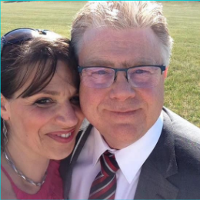
Absolutely brilliant training.
Highly recommend using Rachel.
The training was well delivered in a way that was understandable. Will be putting it to good use at work.
Thank you Rachel.
Geraldine Abruzzese| Bradford Council

Slide 6
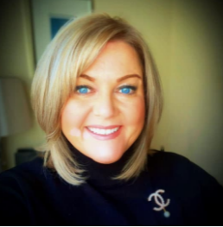
After hearing nothing but fantastic reviews about Rachel I arranged a 1:1 LinkedIn training session.
The purpose of the training was so that I could create some content for our wider team to use to get them all using LinkedIn confidently.
I thought my profile was great on LinkedIn until I spent time with Rachel!
She gave me some great tips and guidance and I have totally revamped my profile and content for the better.
I have also had great feedback from my colleagues on the content I was able to share thanks to Rachel’s first class training.
Georgia Grey| Yorkshire Bank

Slide 7
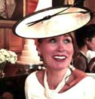
Facebook was a mystery to me. Rachel soon put me at my ease with her warm non-intimidating down to earth approach, she is very generous with her knowledge and she made me feel comfortable and safe to ask about anything that I didn’t get straight away – without feeling stupid!
The amount I learned amazed even me and I have booked another course which I am actually looking forward to!
Rachel has shown me what an amazing media marketing tool Facebook is and taken the mystery out of it, this will be really helpful
in marketing our business.
I wouldn’t hesitate to recommend Rachel’s brilliant
workshops.
Trish Connor | Franchisee Owner, Gymophobics

Slide 8
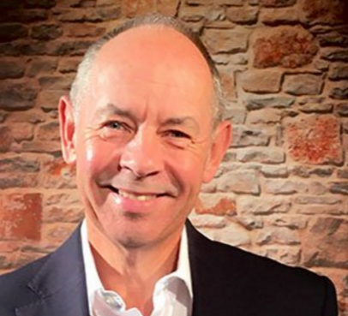
I know Rachel was unsure whether I’d get anything from this workshop, given that I’m also a social media trainer, she needn’t have worried.
I had a thoroughly enjoyable day and learnt plenty, which helped me brush up on my Facebook skills! Rachel, has a really nice relaxed delivery style and works with you, as you fumble around, trying to ensure your press the right buttons or find the right menus.
I would highly recommend Rachel’s workshops, whether you’re a novice or a more seasoned user of Facebook and other social media.
Many thanks Rachel
Steve Philip| LinkedIn Trainer

Slide 9
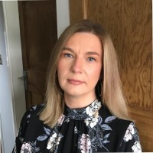
I would strongly recommend Rachel if you need help with your social media. She is a lovely lady, and also incredibly helpful. The advice she gave me I have used and I am SOOO pleased with my profile following her advice and also have gained many more views of my social media profile and posts. I cannot recommend Rachel highly enough and have to say that the 2 hours spent with her was extremely good value for money. If you are thinking about getting help with your social media you cannot do better than ask Rachel!
Karen Hagan | Four Oaks Financial Services

Slide 10
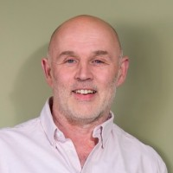
Rachel was fantastic in dragging the Directors into the digital age.
Personable, knowledgeable and brilliant in understanding our business needs.
So much better prepared to explore and take advantage of social media.
Thank you.
Reg Perrin| Director, Lithos Consulting

Slide 11
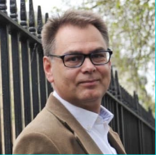
Rachel delivered an excellent workshop as part of Make It York's Business Masterclass training programme. Entitled, "How to spend less time on more of the right things on social media", the content delivered was short, snappy and easy to digest.
Rachel's clear explanation and examples allowed delegates to fully understand the actions they needed to undertake with their own accounts.
I'd recommended Rachel to anyone requiring help with their social media needs.
Mark Bates | Make It York

Slide 12
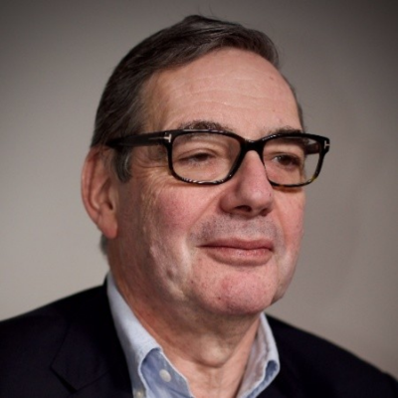
Rachel gets to the heart of the matter of using social media.
Her style is clear and pitched at just the right level. In our group were people who thought they knew LinkedIn quite well and those who were starting the journey.
All of us benefited from her training and advice. Social selling has attracted a few snake-oil salespeople.
Rachel is the real thing and delivers on her promises.
Richard Higham | Sales Levels

Slide 13
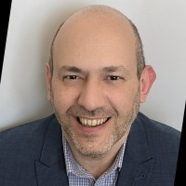
Rachel is a true professional. Lots of knowledge and experience but able to provide a bespoke service to each client.
A pleasure to work with too.
Highly recommended.
Tony Redondo | Cosmos Currency Exchange

Slide 14
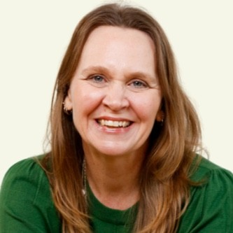
Get MOORE Social Training Hub
I've got a lot out of the two workshops and the training I've attended so far. My mind is popping with clarity, things coming together, and new ideas which is exciting.
It's also really helpful to have the workbooks and the slides, so thank you for sharing those so generously.
Suzanne Gamache | Suzanne Gamache Healing

Slide 15
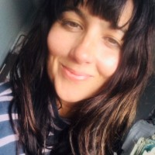
Rachel ran a LinkedIn training session for us earlier this week. We are a small start-up and offer inspirational wellbeing and character support for schools based around inspirational storytelling ...www.amazingpeopleschools.com.
Rachel's session was accessible and really useful - her knowledge is excellent and she was very generous with it. Her clear way of presenting and sharing ideas and information was really easy to retain - we look forward to working with Rachel in the future!
Thanks Rachel
Francis Corcoran | Managing Director, Amazing People Schools

Slide 16
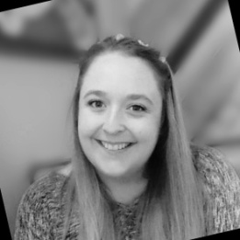
After 5 years out of the game, I was over whelmed and scared of doing things wrong with social media, knowing that it had changed a lot since the last time I marketed in this way.
Rachel has really given me the confidence to utilise social media and email marketing again. She has also gone out of her way to help me get the most out of my marketing with any questions or help I have needed.
She is as friendly as she is knowledgeable! I look forward to working with her again in the future as I know she has a lot more help to give to us once we're ready.
Lydia Welsh | iTouch Systems ltd

Slide 17
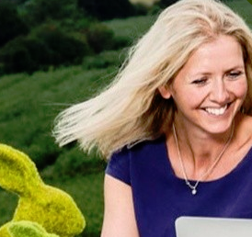
My colleague and I recently had a half day session with Rachel, for training across LinkedIn and Twitter -(although with grateful thanks to Rachel for the other areas we also covered!).
I found Rachel incredibly helpful and she gave very practical advice, which we were then able to implement straight away into the business. I was conscious that I didn't want a session with someone just covering lots of theory. Rachel's way of training was easy to follow and very practical and it was incredibly useful to spend a half day with her.
Tamzin Jefferson | Marketing & Brand Executive, Lead Talent

Slide 18
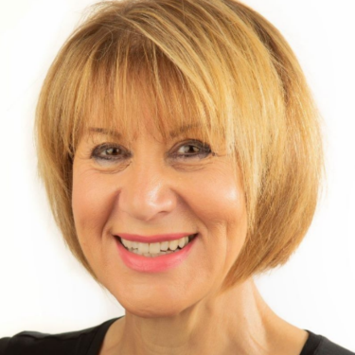
Rachel consistently gets great testimonials from all our members and clients, she has a great deal of expertise in all aspects of social media including training and management.
Rachel is also a strong presenter able to held her audience and give them top tips to takeaway.
Her training is affordable, high quality and fun.
Paula Grizzard | Women In Business Network Franchisee

Slide 19
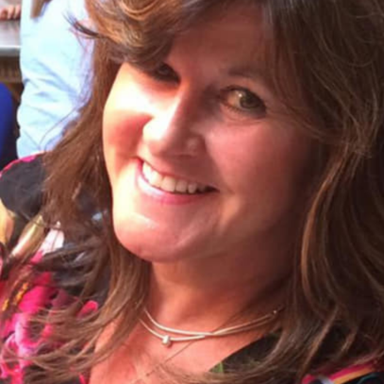
I cannot thank this lady enough for helping me successfully navigate an ongoing issue with my social media business platform.
Your expertise and patience have been so welcome and mind-boggling!
I could not have done it without you!
Thank you Rachel - amazing!
Cathy Dawes-Chapman | Travel Counsellor

Slide 20
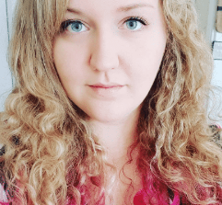
I attended Rachel’s Twitter and Facebook workshops and both were equally excellent.
Everything I needed to know was explained clearly and in sufficient depth and it was helpful to be able to work through it as we went along. I went with specific aims of what I wanted to learn or find out more about but also found out so many more useful features that I didn’t know existed previously.
The techniques Rachel introduced me to have already led to increased following and engagement on both platforms. I’d highly recommend these workshops.
Meg Drage | One Day Trauma, St James’s Hospital

Slide 21
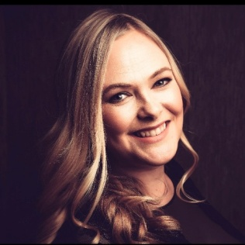
Rachel has helped me to understand the functions of LinkedIn and how to set up my profile properly so I am more marketable and can target Pete trial clients effectively. She is knowledgeable, patient and friendly.
I’d recommend her to anyone needing to know more about LinkedIn and how to make the most of it.
Helen Wild | Human Resources Director, Global Data Plc

Slide 22
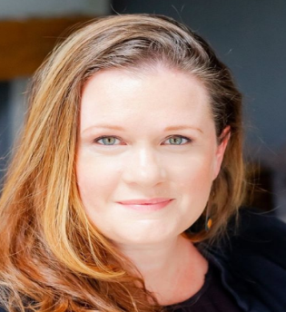
Last week at a Networking event I organise, we had the pleasure of Rachel being our guest speaker, talking about LinkedIn. Rachel was well prepared, knowledgeable and incredibly inspiring about how we could leverage the power of LinkedIn for our businesses. Many thanks, Rachel for your time and enthusiasm around all things social media.
Anisa Lewis | Positive Parenting Coach

Slide 23
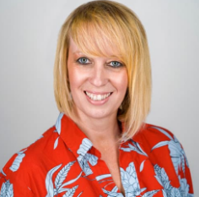
Thank you Rachel for such a fantastic and insightful workshop. I really enjoyed the whistle stop tour of the social media platforms and learnt so much.
This is definitely hands down the best social media training course I have ever been on and wouldn't hesitate to recommend you to other local businesses as the go-to social media guru.
Becky Gosling | Bee Events

Slide 24
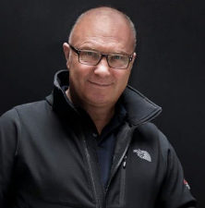
I have recently attended two of Rachel's training courses and I must say that they were both exactly what I needed.
The information, pace and atmosphere of the LinkedIn and Blogging courses were fantastic and I found both courses extremely useful.
I am sure at some point I will be back for more.
Thanks Rachel."
David Cole | David Cole Photography

Slide 25
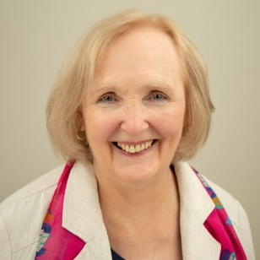
I met Rachel whilst networking. I was looking for some social media training, and was immediately impressed with the broad spectrum of training Rachel offered, and with the possibility of bespoke tutorials, as I had little social media experience.
I chose the one-to-one 12-hour course which gave me a flexible programme of tutorials, tailored to my specific needs, with practical exercises to support each session.
As a result of the training, I have a great LinkedIn page and a better understanding of how to use the page to promote my business. I also booked onto another of Rachel’s courses – the Social Media Content Creation & Automation workshop which was highly informative and helpful and provided the tools to build an interactive social media presence.
I would highly recommend Rachel to anyone who is
looking for similar training.
Lynn Edgar | Wellbeing Coach

Slide 26
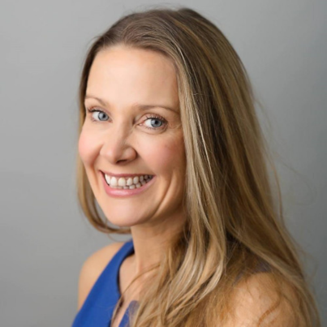
I have trained with Rachel both on a one to one basis and via her groups for Facebook, Blogging, Facebook Ads and most recently LinkedIn.
Rachel is clear, concise, works at my pace and has made a technophobe like myself, confident in using social media! Rachel's training has been an absolutely invaluable tool for building my business and my confidence and I cannot recommend her highly enough.
Affordable, detailed training that is adapted to the individual - I will be back to further enhance my skills.
Karen Brindle | The Weight Loss Queen

Slide 27
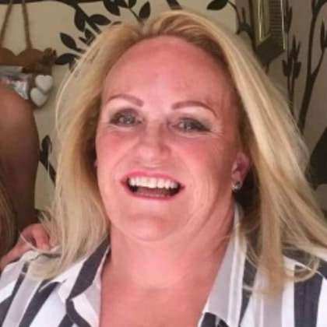
I can’t say enough about this lady....
If you need to know the ins and outs of FB or any social media and need more business Rachel Moore is a fantastic teacher, and has amazing knowledge of her subjects.
I’ve learnt so much being on one-to-one's with her, more than I ever could have in a small group. It’s well worth the investment
Kay Campling | The Lincolnshire Lipo Clinic

Slide 28
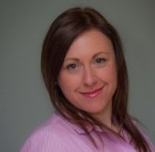
Rachel provided LinkedIn training to both my husband and I because we wished to grow our business through social media.
The advice she provided on how to optimise our profile in order to get found was particularly useful.
The changes she suggested that we make resulted directly in us securing new business within a short space of time from one contact in particular
who told us they found Urban Living Property Management
via my profile.
Paula Twist | Urban Living Property Management

Slide 29
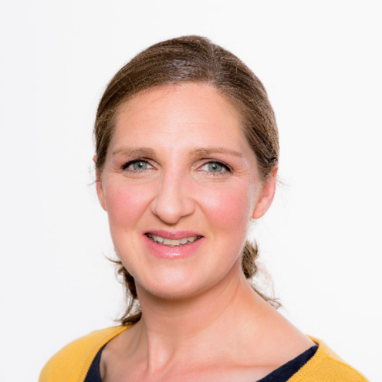
As a new business owner Rachel's 1-2-1 social media training
has been perfect. Extremely flexible, cost effective and tailored to
my needs.
Rachel offers relaxed training that works for you and your business. Lots of great tips and tricks and you don't ever feel your question
is a 'stupid one'.
Both Face-2-Face and via Zoom her sessions fit around your schedule.
Now just to put everything into practice!
Thanks Rachel.
Louise Reid | Reid PA Services

Slide 30
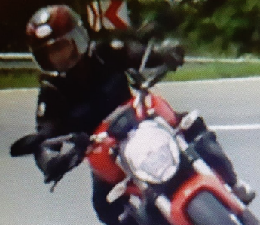
I recently attended Rachel’s 1 to 1 Linked-in workshop. I thought my profile page was fairly good compared to others I had seen and already had 3000+followerss but throughout the session, I realised there was so much more I could be doing. Rachel has given me the tools to up my game considerably when it comes to increasing my ability to generate quality contacts to promote my services and expertise.
I now rank 1st in a search for a particular subject - above the actual author of the governmental guidance document which I am very pleased about. The session being a 1 to 1 really benefited me as it allowed Rachel to work through my website and make her comments. I wrote so many notes from the session to take away I am still working away through all the pointers.
I have now subscribed to her BBW (Building Business Workshop - 6 session/monthly workshop which I am very much looking forward to attending.
I do not hesitate in recommend Rachel to anyone who wants to increase their social media profile in order to generate more business for their company.
Gill Cousins
Business Development Director, Noise & Vibration Services

Slide 31
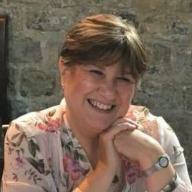
I can highly recommend Rachel to anyone wanting to increase their knowledge of the crazy world that is Social Media! I recently attended a Social Media for Business workshop hosted by Rachel. I knew there was so much more to social media but didn't know how to utilise all the tools available to their full potential. Rachel's workshop opened up a whole new world and made me realise just how important it is to use Social Media and more importantly make it work for us as a business. There are so many 'tricks of the trade'! Rachel didn't once make anyone feel uncomfortable if their knowledge wasn't as great as someone else's in the room, she made everyone feel at ease, and took the time to explain things clearly and concisely.
Carole Green | She Loves York & Harrogate

Slide 32
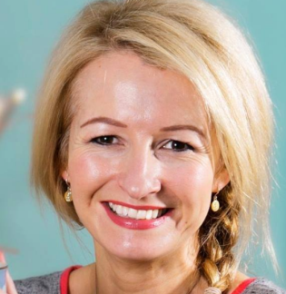
I recently attended a networking event where Rachel delivered a fantastic training session on LinkedIn. Myself and most of the attendees were business owners looking to better understand LinkedIn and how it can benefit our different businesses. Great session with lots of stats, tips and info, plenty of advise and a great Q&A at the end. Now I just need to find the time to put it all into practice.
Heidi Marfitt | Heidi Marfitt Photography

Slide 33
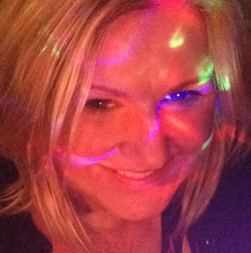
I had a great, 2 hour, one to one FACEBOOK session with Rachel and we covered loads during that time.!
Rachel is so knowledgeable and answered all my questions and helped me with much more than I expected.
I now feel confident in using my business pages, getting more likes as well as keeping it informative and interesting for both myself and my followers ☺ Thank you Rachel!
Claire Beecroft| Raw Food For Healing

Slide 34
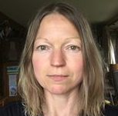
Rachel’s Facebook for business for beginners course was very useful and easy to follow with lots of helpful suggestions as to how best maximise a business page.
There’s was plenty of opportunities throughout the day to get one to one support which I found particularly useful. I would recommend this course to anyone starting to use a business page.
Caroline Barton | Nooj Food

Slide 35
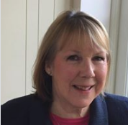
Facebook for Business was just what I needed to help overcome my many fears and prejudices.
Rachel was an excellent tutor and I found the training very straightforward and clear. Beforehand I'd only half understood it and been going round in circles - now Rachel has given me the confidence to put what I learnt into practice.
Many thanks Rachel
Sarah Standeven
Office, Office Virtual Executive Support

Slide 36
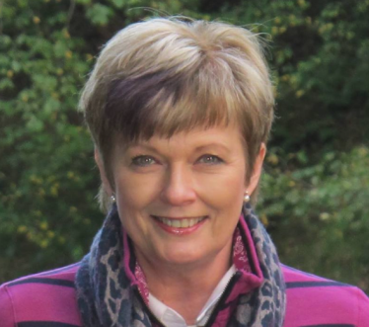
This is the type of specialist training that I didn’t think existed.
Worried about knowing nothing? Don’t! Worried about looking stupid? Don’t! Worried that it will be a waste of money? Don’t be! Expert value for money tuition, geared totally to the individual.
Rachel’s clarity of explanation is a rare skill. She’s quietly inspiring, massively knowledgeable, excellent at building confidence and makes you feel like you can succeed – all key components for effective learning.
Thanks Rachel, I’ll be recommending you without hesitation.
Kate Henderson Nichol | Author

Slide 37
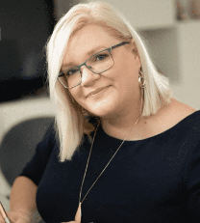
I recently had a days training with Rachel, it was so valuable and I learnt so much, her tips were great and her knowledge fantastic.
The practical workshop allowed me to action key tasks and the tips that I took away have given me more to focus on.
Since this, I was able to populate some key information on my business page and have even filmed my first Facebook live! - highly recommended.
Lisa Sheppard | Business Gears Management Consultancy

Slide 38
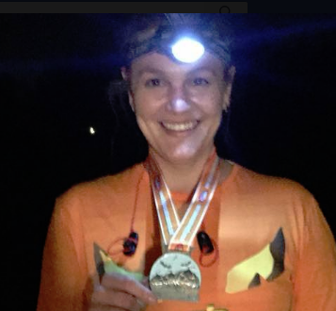
We spent an afternoon with Rachel in a private social media teaching session. We learnt so much and it was really enjoyable.
Will definitely use again.
Stephanie Loveridge | Equine Kind – Behaviour Specialist

Slide 39
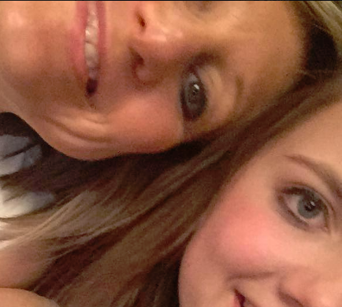
Thank you Rachel, what a great blogging workshop today. I learnt many new valuable thing about publishing my blog within WordPress, great ways of improving content and where to source ideas for my blogs to name but a few with lots of top tips thrown into the bargain.
I have to say the workshop was really good value. I will most certainly be attending another workshop very soon.
Michelle Crowther | Crowther Accountants

Slide 40
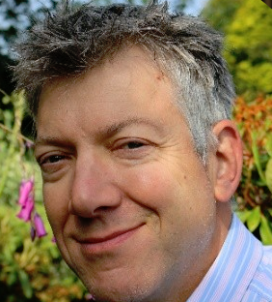
Rachel's easy and professional delivery style has opened my eyes to the benefits of marketing my business via social media and specifically LinkedIn.
I recently attended one of Rachel's half day LinkedIn courses which I found to be both thorough, and unusually for training courses, delivered at pace.
The supporting content has enabled me to get on and create a valuable marketing tool. Thank you.
Adrian Barraclough | AKB Environmental Limited

Slide 41
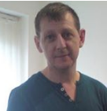
I have just watched the training videos for the third viewing, not just because I enjoyed them but I didn’t take it all in due to the amount of great content Rachel has put into them.
I have been marketing on Facebook for a couple of years now and have been taught by the so called gurus but let me tell you in all honesty Rachel Moore could teach them a thing or two about Facebook marketing.
This product is the best training I have bought on Facebook.
Kevan Cowley | Online Marketer

Slide 42
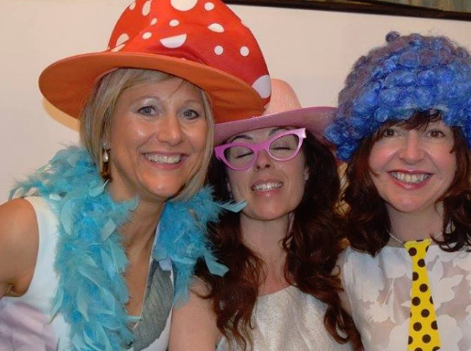
Fantastic Blogging workshop with Rachel today! Rachel is so accommodating and really helped with the specifics I needed to get to grips with. And the amount of tips I have come away with alone would make it worth it, an absolute bargain! Really looking forward to getting started on the blogging. Thank you Rachel
Hayley McAllister | She Loves York & Harrogate

Slide 43
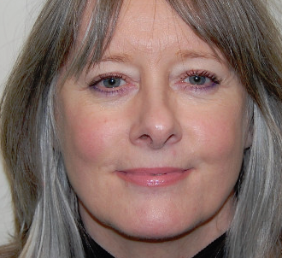
I highly recommend Rachel for social media training, I took advantage of the fact that Rachel provides 1-2-1 training as well as a variety of workshops, it is great to have options and I found the time spent with her has been really effective and great value.
Rachel has a way of explaining things that make it easy and instils confidence. Her help in coming up with ideas and the best way to present yourself adds value to the experience.
Rachel is fun to work with and I found our sessions both rewarding and relaxing, I recommend anyone to check out what Rachel has to offer because we don’t know what we don’t know and in my opinion the best way is to learn is from an expert
Sally Steedman | Freedom Business Services

Slide 44
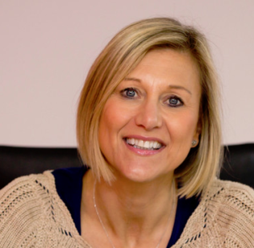
Rachel held a LinkedIn workshop at our offices. This workshop allowed everyone to readdress their LinkedIn profile and think about putting a strategy in place to start being more proactive on this platform.
As always Rachel delivers a knowledgeable, clear and concise programme. She ran the workshop at a pace that allowed every person attending to get the most out of the time they were there. The bonus was that Rachel gave us lots of hints and top tips for future application. It was personally a great refresher for me. Thank you, Rachel for yet another excellent workshop.
Michelle Crowther | Crowther Accountants

Slide 45
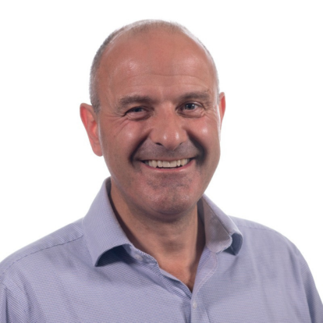
Like the Rachel’s LinkedIn workshop that I did before Christmas, the Rachel’s Facebook workshop last week was superb.
She has a knack of pitching the content to meet the various levels of the people on the course and ensuring that no one feels left behind yet everybody learns lots.
It is impossible to go on one of Rachel’s courses and
not feel as though you have
great value for money.
Bill Anderson | Puravent

Slide 46
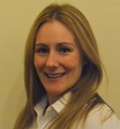
Had a two hour 1-2-1 training session with Rachel on Facebook.
Who knew there was so much you could do on it for your business?
Well, you will if you have a session with her.
Excellent training, friendly and Rachel tailored it towards my industry.
Would recommend.
Janine Kot | U recruit

Slide 47
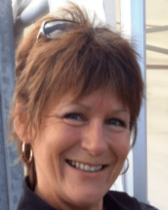
Exceeded all my expectations on my Facebook training course today with Rachel.
Not only did I have all my questions answered but I learnt so much more.
Her style of teaching was very knowledgeable and professional in its delivery and this, coupled with Rachel's
personal and flexible approach made for
an excellent day.
Thank you.
Nicola Hulme | Simply Stitch

Slide 48
Many thanks to Rachel Moore for some great training on a variety of social media applications. Hootsuite was particularly useful and some of her advice on LinkedIn was brilliant.
Many thanks Rachel
Thank you.
Jonathan Wurr | Look Up Consulting

Slide 49
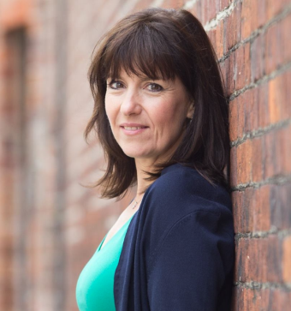
Thanks for a great workshop today on Mailchimp Rachel. It has mystified me for years and stopped me getting my lists and newsletters in order.
Well, no more excuses for me – you made the session easy to understand, fun and effective. Now i feel confident and eager to have a go.
Thank you so much Emmy – x –
Emmy Yeadon | Emmy Yeadon Associates

Slide 50
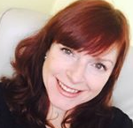
I saw Rachel speak at an event and within the half an hour presentation I learned so many little tricks of the trade around Facebook. This then prompted me to sign up for a 1-2-1 session with Rachel as my knowledge around social media wasn’t great!
Rachel explained the social media process using very simple and easy language so I could absorb everything and gained so much more knowledge within the first 15 minutes of the session which made me even more eager to learn.
I would highly recommend Rachel as she is such an expert
in this field and gaining an insight to social media and
it’s importance can only benefit your business.
Libby Steggles-Ginn | The Emoji Coach

Slide 51
I met Rachel for the first time at a Harrogate College workshop for new businesses where she gave a lecture on how to use social media to promote our businesses to a wider audience. She had a friendly approach and made the lessons enjoyable which in turn helped us feel at ease as newcomers.
Rachel was very professional and informative with regards to teaching and was clear and precise with the information given. She certainly knew her stuff.
A lot of printouts were given out whilst the power point slides were shown in order for us to make notes and follow through. These were extremely useful in referring back to when needed. A lot of encouragement and patience was given by Rachel and she was always willing to repeat things if anyone didn’t understand the firs t time.
Rachel has stayed in contact with me to check on how I was
copying with the new knowledge and if I needed any guidance
she was always at the end of the phone or email. She is now
helping me to improve my LinkedIn account.
Carole Read | CPR Drawings/Genealogy

Slide 52
I just wanted to say – Thank You! ☺
It has been just over a year since I discovered you! Your ‘I’m a REAL PERSON’ approach in the videos and webinars make absorbing the information much easier. Often I feel like I am getting 1-2-1 tuition.
Julie Badger | Empower Network

Slide 53
Contact Details
Rachel Moore Social Media
01423 529 708 | 07904 007 660
rachel@rachelmooresocialmedia.com
www.rachelmooresocialmedia.com

